Slide 1
PROJECT -5
NextHikes IT Solutions Project 5: User Analytics in the Telecommunication Industry - Overview
Name – SANTOSH
Mobile no – 8377011874
Batch - Digicrome Academy | Data Science and AI | N-140724-E8-SS-27
T

Slide 2
Start from here----------- run needed libraries import pandas as pdimport numpy as npimport matplotlib.pyplot as pltimport logging import seaborn as sns import sklearnfrom sklearn.model_selection import train_test_splitfrom sklearn.linear_model import LinearRegressionfrom sklearn.metrics import mean_squared_error, accuracy_scorefrom sklearn.cluster import KMeansfrom sklearn.datasets import load_iris

Slide 3
logger = logging.getLogger('my_logger')logger.setLevel(logging.DEBUG)# File handlerfile_handler = logging.FileHandler('app.log')file_handler.setLevel(logging.DEBUG)# Console handlerconsole_handler = logging.StreamHandler()console_handler.setLevel(logging.INFO)# Formatterformatter = logging.Formatter('%(asctime)s - %(levelname)s - %(message)s')file_handler.setFormatter(formatter)console_handler.setFormatter(formatter)# Add handlers to loggerlogger.addHandler(file_handler)logger.addHandler(console_handler)# Sample logslogger.info("Logging to both console and file.")logger.error("An error occurred.")def load_and_log_iris_data(): logger.info("Loading the Iris dataset") iris = load_iris() iris_df = pd.DataFrame(data=iris.data, columns=iris.feature_names) logger.debug("Iris dataset loaded successfully")

Slide 4
df.head(5)
df.tail(5)
df.info()
df.tail(5)
df.info()
etc

Slide 5
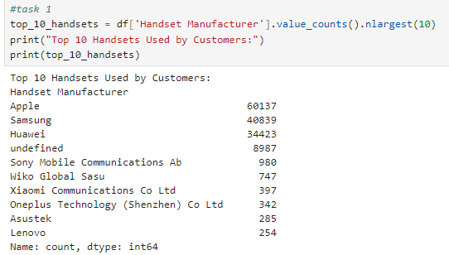
START

Slide 6
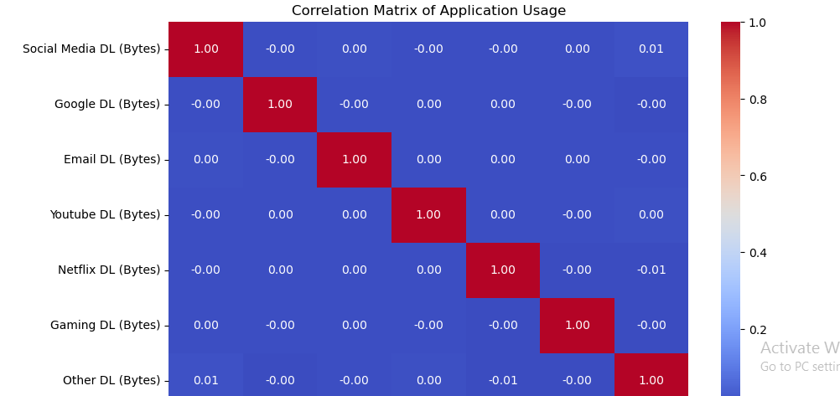

Slide 7
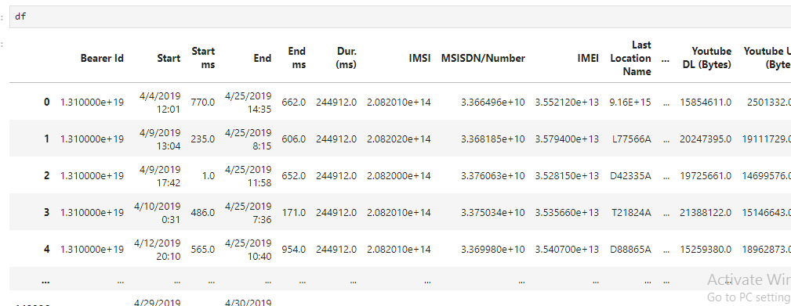

Slide 8
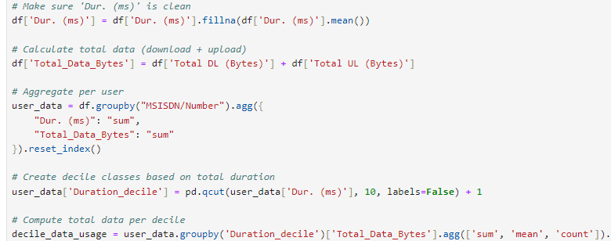
df["Total_Data_Bytes"] = df["Total DL (Bytes)"] + df["Total UL (Bytes)"]# Total session time in secondsdf["Duration_s"] = df["Dur. (ms)"] / 1000

Slide 9
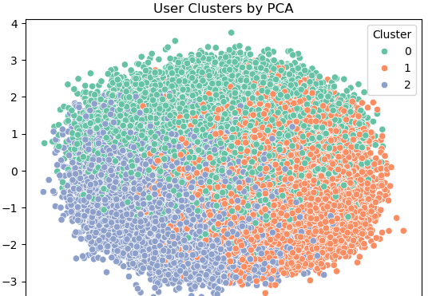
Visualize clusters

Slide 10
THANKYOU

